Slide 1

Employee Data Analysis using Excel
STUDENT NAME: Keerthana G
REGISTER NO: 312211451
DEPARTMENT: B.COM(GENERAL)
COLLEGE: ALPHA ARTS AND SCIENCE COLLEGE
1
Notes:
1

Slide 2

PROJECT TITLE
Employee Performance Analysis, Employee Status, Martial Status and Employee Type using Excel
2

Slide 3



AGENDA
Problem Statement
Project Overview
End Users
Our Solution and Proposition
Dataset Description
Modelling Approach
Results and Discussion
Conclusion
3/21/2024 Annual Review
3

Slide 4

PROBLEM STATEMENT
Conducting employee performance analysis is crucial for enhancing productivity and aligning individual efforts with organizational goals.
It helps identify strengths and areas for improvement, ensuring that employees receive constructive feedback and targeted development opportunities.
This process also supports fair evaluations, recognizes high performers, addresses performance issues, and informs strategic planning, ultimately driving employee engagement and organizational success.
4

Slide 5

PROJECT OVERVIEW
This analysis evaluates employee performance across ten business units, totaling 2,999 employees.
Performance Levels:
MEDIUM: Dominates with 177 employees.
LOW: Significant at 93 employees, indicating potential areas for improvement.
HIGH: 2360 employees show strong performance.
VERY HIGH: 369 employees excel exceptionally.
Business Unit Highlights:
SVG: Highest total with 233 employees and balanced performance levels.
PL: Lowest total with 12 employees, requiring focused development efforts.
The goal is to pinpoint trends, celebrate high achievers, and address performance gaps to boost overall effectiveness.
5

Slide 6

WHO ARE THE END USERS?
STAKEHOLDERS
Employees:
Feedback and Development: Offers constructive feedback for personal growth and career development, potentially increasing job satisfaction.
Recognition: Highlights high performers, boosting morale and motivation.
Management:
Decision-Making: Provides data-driven insights to make informed decisions about promotions, training, and resource allocation.
Strategy Development: Helps align employee performance with organizational goals and identify areas for strategic improvement.
Investors/Shareholders:
Performance Impact: Offers insights into employee performance that can affect overall company productivity and financial performance.
Risk Management: Helps in identifying potential risks related to workforce performance and strategic execution.
6

Slide 7

OUR SOLUTION AND ITS VALUE PROPOSITION
Conditional formatting – Find missing area
Filter – Remove blanks
Formula – Allocate the performance level
Pivot – To get detailed summary
Graph – Prepare the data visualization
7

Slide 8
Dataset Description
Employee Details – Kaggle
Total features – 29
Relevant features – 9
Employee id – Numerical value
Name – Text
Gender – Male , Female
Employee rating – Numerical value
Performance level - Grading

Slide 9

THE "WOW" IN OUR SOLUTION
We used the below formula to grading the employee performance level , which help us find their efficiency .
=IFS(Z9>=5,"VERY HIGH",Z9>=4,"HIGH",Z9>=3,"MED","TRUE", "LOW")
3/21/2024 Annual Review
9

Slide 10
MODELLING
Data collection
Koggle – Using this website to collect the data for the project.
Feature collection
Excel spread sheet - Excel sheet is used to arrange the relevant data.
Data cleaning
Conditional formatting – Used to identify the blank area.
Filter Option – This option is used to remove the blanks.
Performance Level
Grading - We use the “IFS” formula to grading the employee performance level
Formula =IFS(Z9>=5,"VERY HIGH",Z9>=4,"HIGH",Z9>=3,"MED","TRUE", "LOW")
10

Slide 11
MODELLING
Summary
Pivot table – We use the pivot table to get crisp and clear data about the employee performance . For that we used the below details :
Filter – Gender
Column -Performance level
Row – Business Unit
Value – Count of First name
Visualization
Graph – Graph show the result of this analysis.

Slide 12
TABLE 1- OVERALL PERFORMANCE OF EMPLOYEES IN BUSINESS UNITS
Bu | High | Low | Medium | Very Hiigh | Grand Total
BPC | 235 | 8 | 24 | 36 | 303
CCDR | 233 | 10 | 17 | 39 | 299
EW | 240 | 7 | 16 | 39 | 302
MSC | 226 | 11 | 20 | 39 | 296
NEL | 251 | 12 | 11 | 30 | 304
PL | 241 | 10 | 16 | 34 | 301
PYZ | 228 | 13 | 23 | 35 | 299
SVG | 233 | 5 | 20 | 46 | 304
TNS | 233 | 8 | 15 | 41 | 297
WBL | 240 | 9 | 15 | 30 | 294
Grand Total | 2360 | 93 | 177 | 369 | 2999

Slide 13
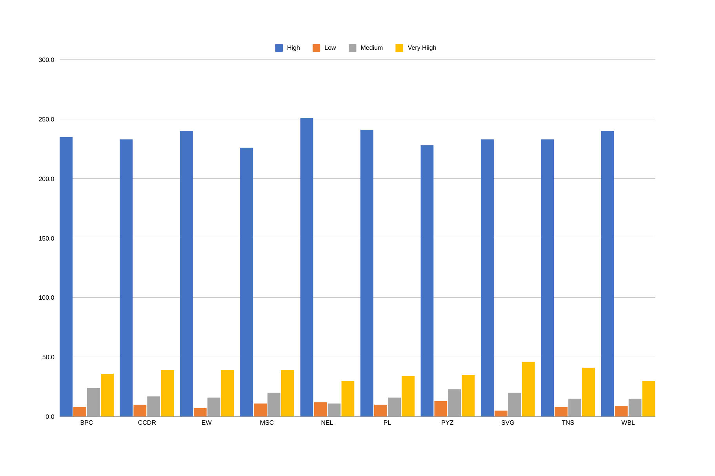

Slide 14
TABLE 2- EMPLOYEE STATUS, EMPLOYEE TYPE & MARITAL STATUS OF BUSINESS UNITS
Employee Status & Martial Status | Employee Type | Employee Type | Employee Type | Grand Total
Employee Status & Martial Status | Contract | Full-Time | Part-Time | Grand Total
Active | 828 | 850 | 779 | 2457
Divorced | 214 | 210 | 184 | 608
Married | 225 | 219 | 178 | 622
Single | 195 | 210 | 230 | 635
Widowed | 194 | 211 | 187 | 592
Future Start | 31 | 16 | 22 | 69
Divorced | 8 | 3 | 4 | 15
Married | 8 | 4 | 4 | 16
Single | 12 | 3 | 6 | 21
Widowed | 3 | 6 | 8 | 17
Leave of Absence | 26 | 25 | 35 | 86
Divorced | 5 | 7 | 14 | 26
Married | 7 | 4 | 7 | 18
Single | 6 | 10 | 4 | 20
Widowed | 8 | 4 | 10 | 22
Terminated for Cause | 17 | 27 | 22 | 66
Divorced | 4 | 5 | 2 | 11
Married | 5 | 7 | 8 | 20
Single | 4 | 7 | 6 | 17
Widowed | 4 | 8 | 6 | 18
Voluntarily Terminated | 105 | 120 | 96 | 321
Divorced | 30 | 30 | 21 | 81
Married | 30 | 32 | 26 | 88
Single | 24 | 29 | 25 | 78
Widowed | 21 | 29 | 24 | 74
Grand Total | 1007 | 1038 | 954 | 2999

Slide 15
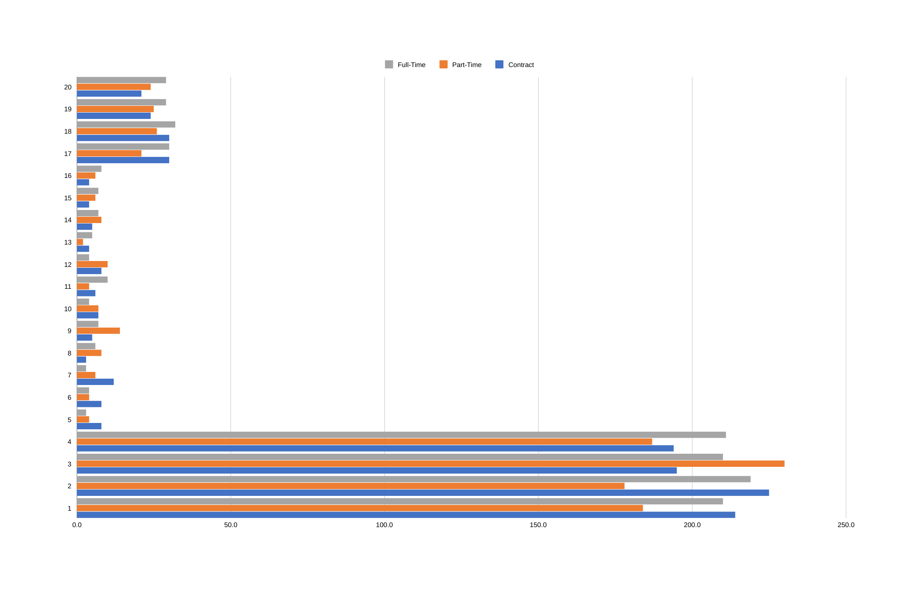

Slide 16
conclusion
The employee performance analysis reveals a predominant concentration of employees in the MEDIUM performance category, indicating an average performance level across the organization. With 177 employees at this level, targeted interventions are needed to elevate performance.
The LOW performance 93 category, with employees, highlights areas for potential improvement and support.
Conversely, the HIGH (2360 employees) and VERY HIGH (369 employees) performance levels show a strong and exceptional workforce that drives significant organizational success.

